Slide 1



Charting co-authoring
networks in TS
Luc van Doorslaer & Irmak Mertens luc.vandoorslaer@ut.ee
Graz, 28 Oct 2022

Slide 2

social studies and T(S)
sociology of T: T as a social practice, ethnographic methods, translator studies, T flows
“movability of T” (Polezzi) and translators/scholars
e.g. historical research of Philipp Hofeneder

Slide 3
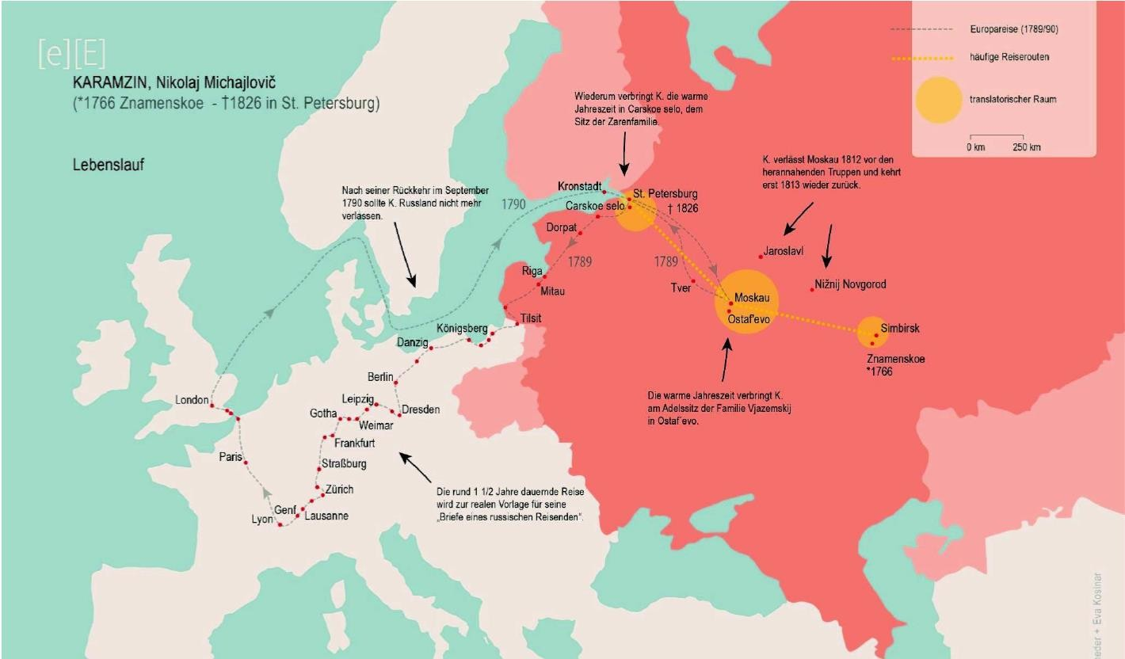

Slide 4
social studies and T(S)
sociology of T
“movability of T” (Polezzi) and translators/scholars
e.g. historical research of Philipp Hofeneder
- what about data on (social, spatial, epistemological) development of TS?

Slide 5
< Basalamah (2016)
“a metatheoretical effort would also include a sociological study of TS scholars themselves” “Such a reflexive work […] would entail identifying the socially and politically-based
intertextual underpinnings of their works and further perform an anthropological study of their
workplace, processes, and research methods”
“This means that metatheory is an encompassing task that includes not only the
socio-anthropological study of TS scholars and science in the making, but also the epistemological reflection overseeing the paradigmatic structuration of its theories and methodologies as well as its direction and continuing development.”

Slide 6

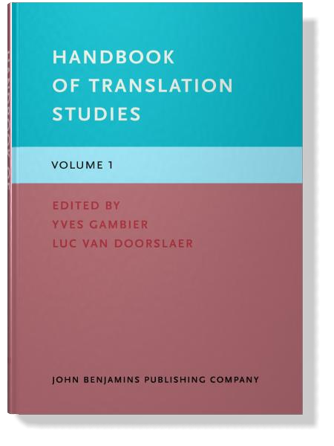

Slide 7
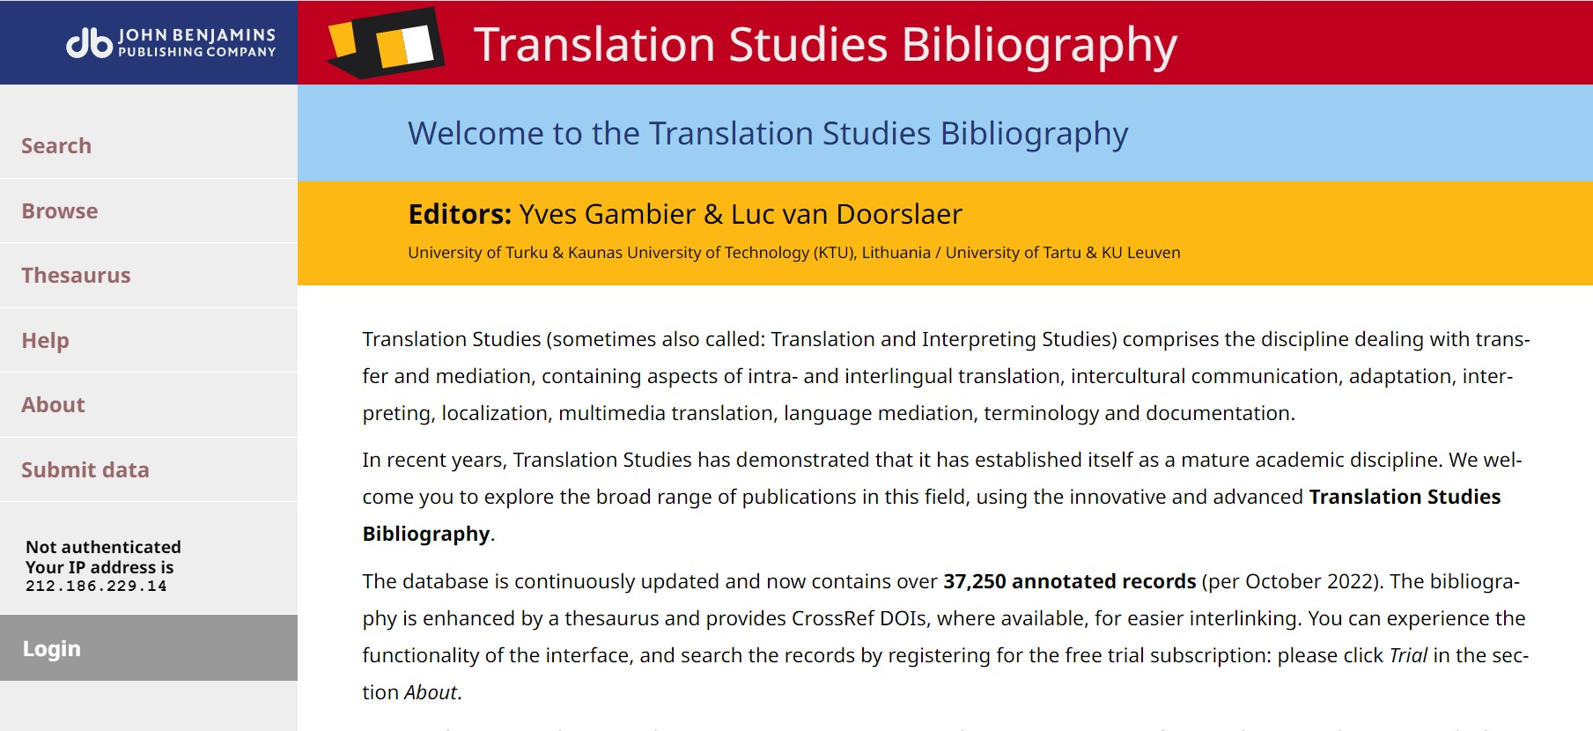

Slide 8
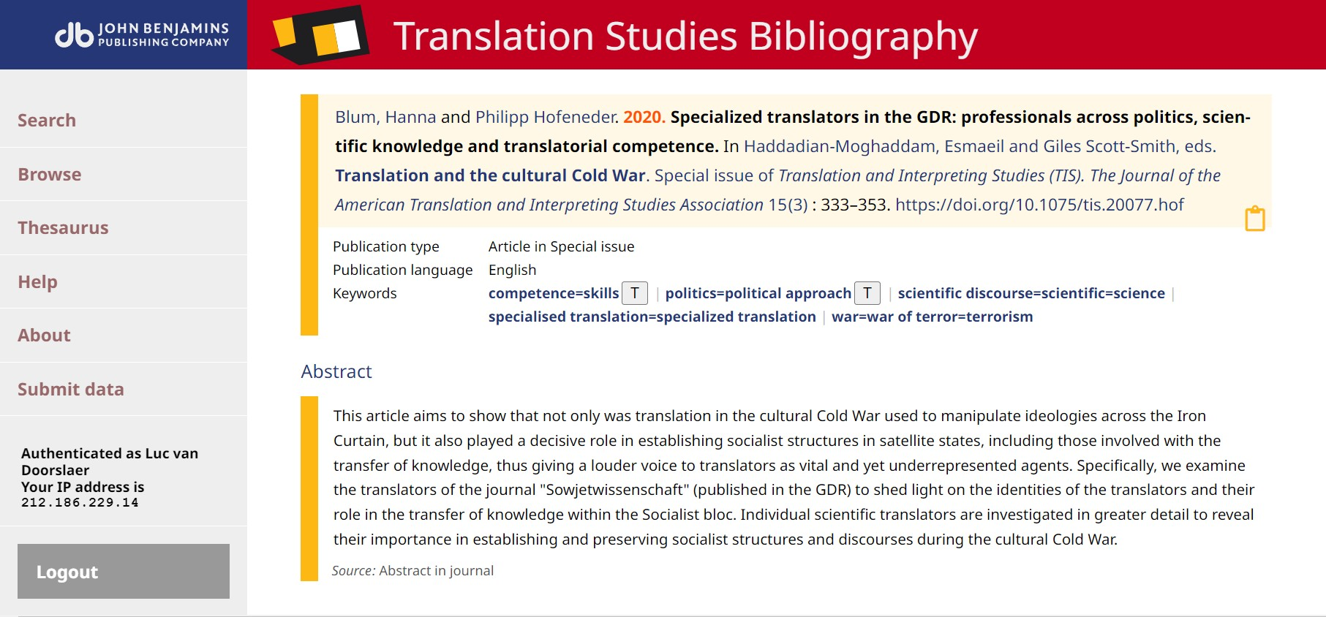

Slide 9
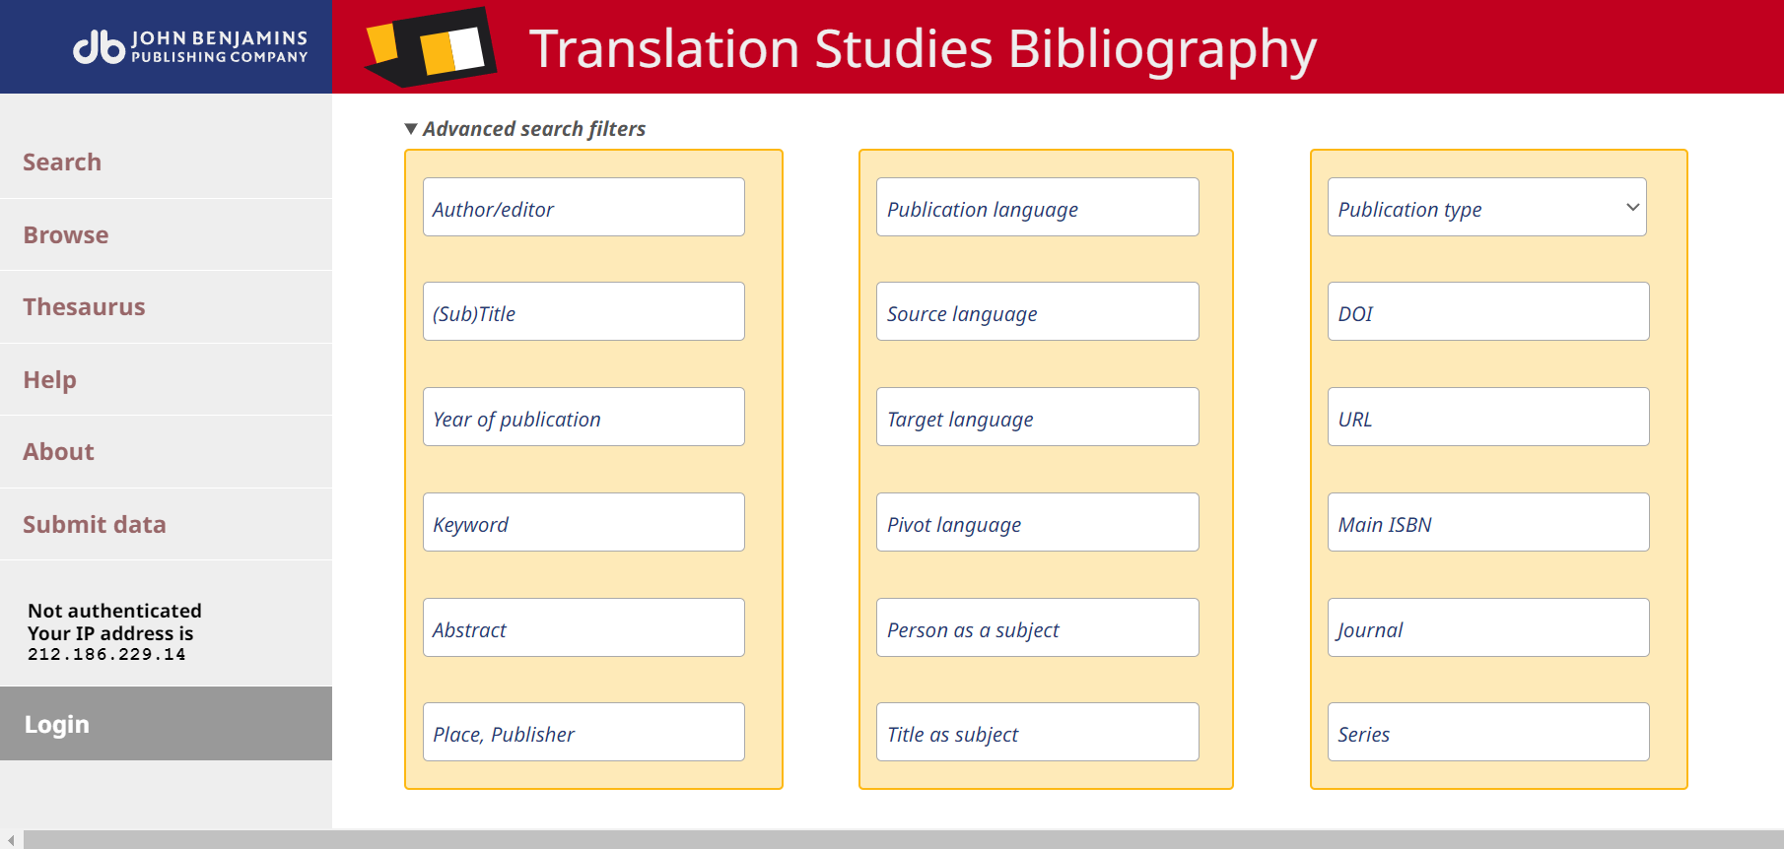

Slide 10
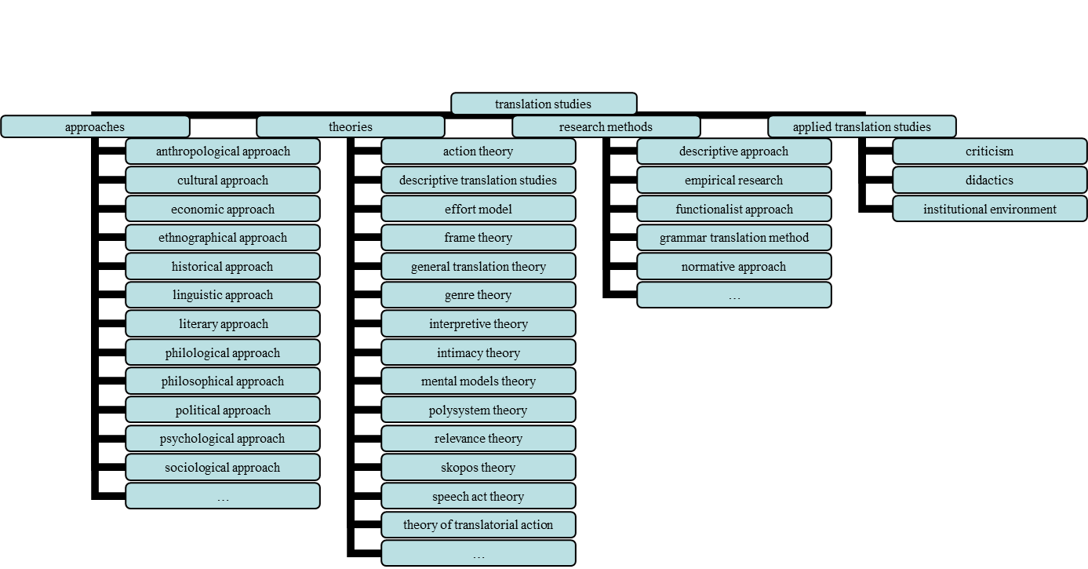
conceptual maps based on TSB keywords (2007)

Slide 11
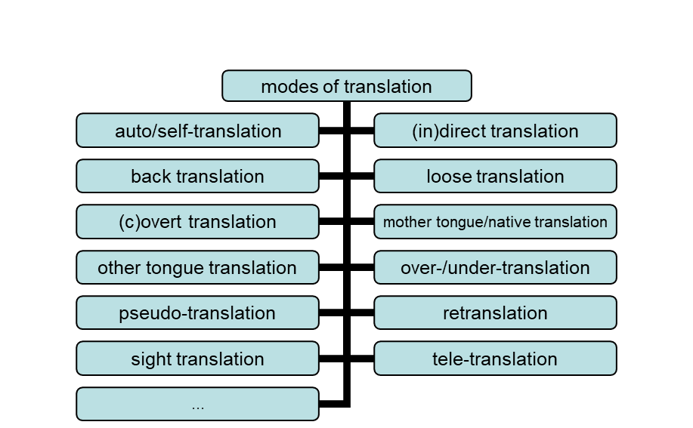
e.g. modes of T (2007)

Slide 12
simplicity of relationships
What exactly do maps tell us about relationships? “little arrows all over the place” (Pym 1998)
“Maps are peculiar instruments of power. They tend to make you look in certain directions; they make you overlook other directions.” (Pym 1998)
Nevertheless (after a failed attempt with Gephi): some more simple counting and bars in
vD&Gambier 2015

Slide 13


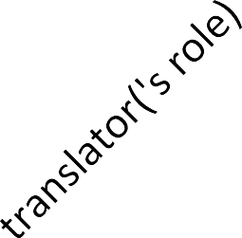


keywords The Translator
40
35
30
25
20
15
10
5
0

Slide 14





keywords Target
45
40
35
30
25
20
15
10
5
0

Slide 15




keywords Meta
45
40
35
30
25
20
15
10
5
0

Slide 16
keywords Catalan
60
50
40
30
20
10
0
literature
audiovisual
literary
translation
historical
approach
poetry

Slide 17
keywords Chinese
30
25
20
15
10
5
0
historical
approach
translation
theory
poetry
literary
translation
culture

Slide 18
keywords English
1200
1000
800
600
400
200
0
machine
translation
culture
literature
historical
approach
comparative
research

Slide 19
bibliometric/quantitative approaches
depending on:
availability of data
focus of researcher
available software
added value: contextualization and triangulation

Slide 20

affiliations in TSB
300
250
200
150
100
50
0

Slide 21
institutional collaborations in TS
based on affiliations, on co-authoring, on journals, etc.
→ scholarly networks
→ charting/mapping collaborations
sample shown today: co-authored publications of 2019

Slide 22
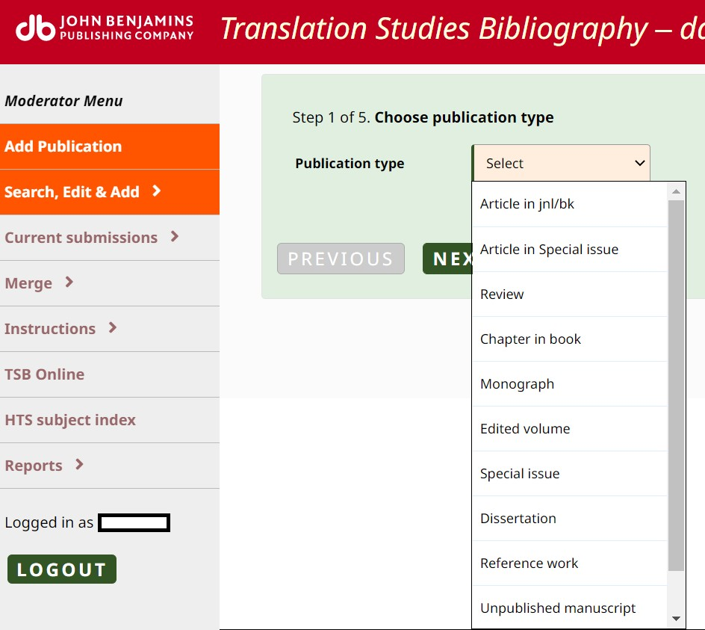

Slide 23
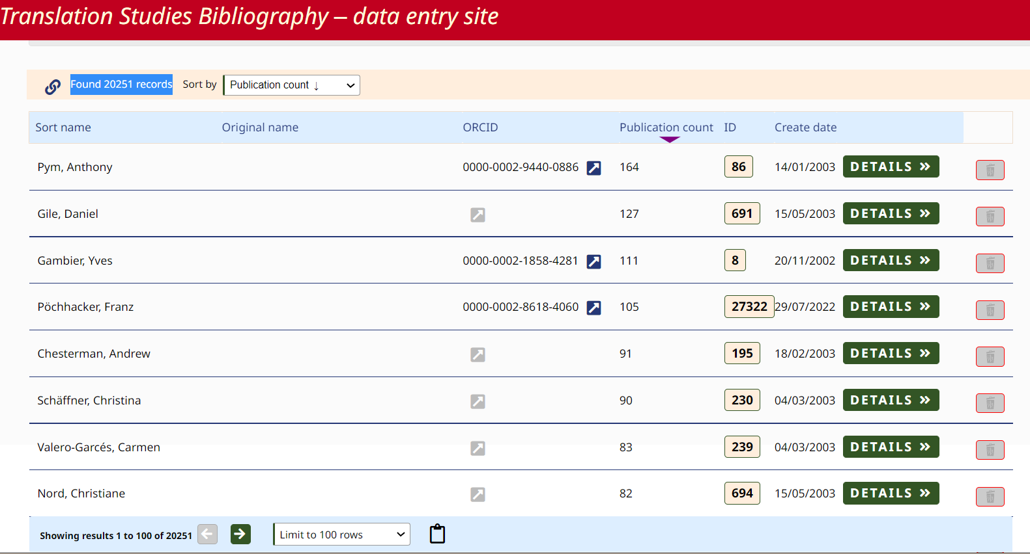
THE CONTENTS OF TSB - AUTHORS
Currently, there are 20251 authors in the database.

Slide 24
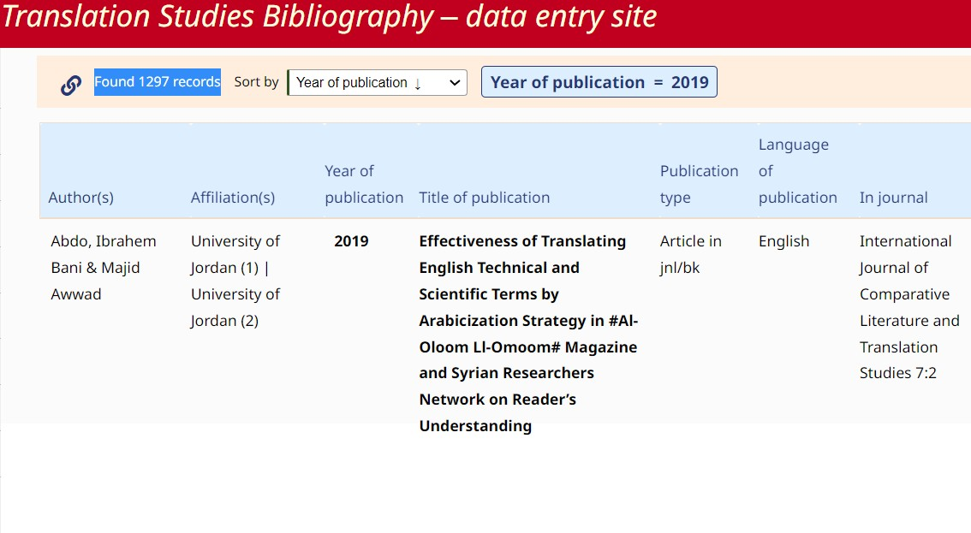
PILOT PROJECT: AUTHORS AND THEIR PUBLICATIONS IN 2019
There are 1297 entries in 2019, out of which 396 publications are co-authored.

Slide 25
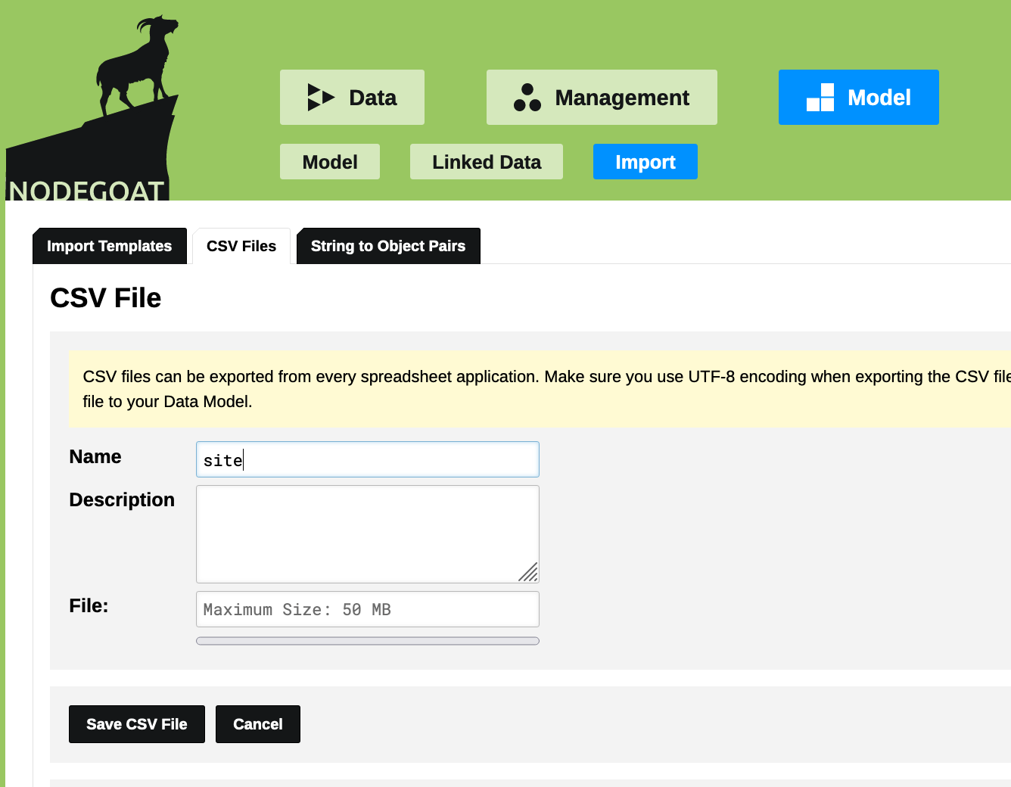




WHAT IS NODEGOAT?

Slide 26


METHODOLOGY

Slide 27
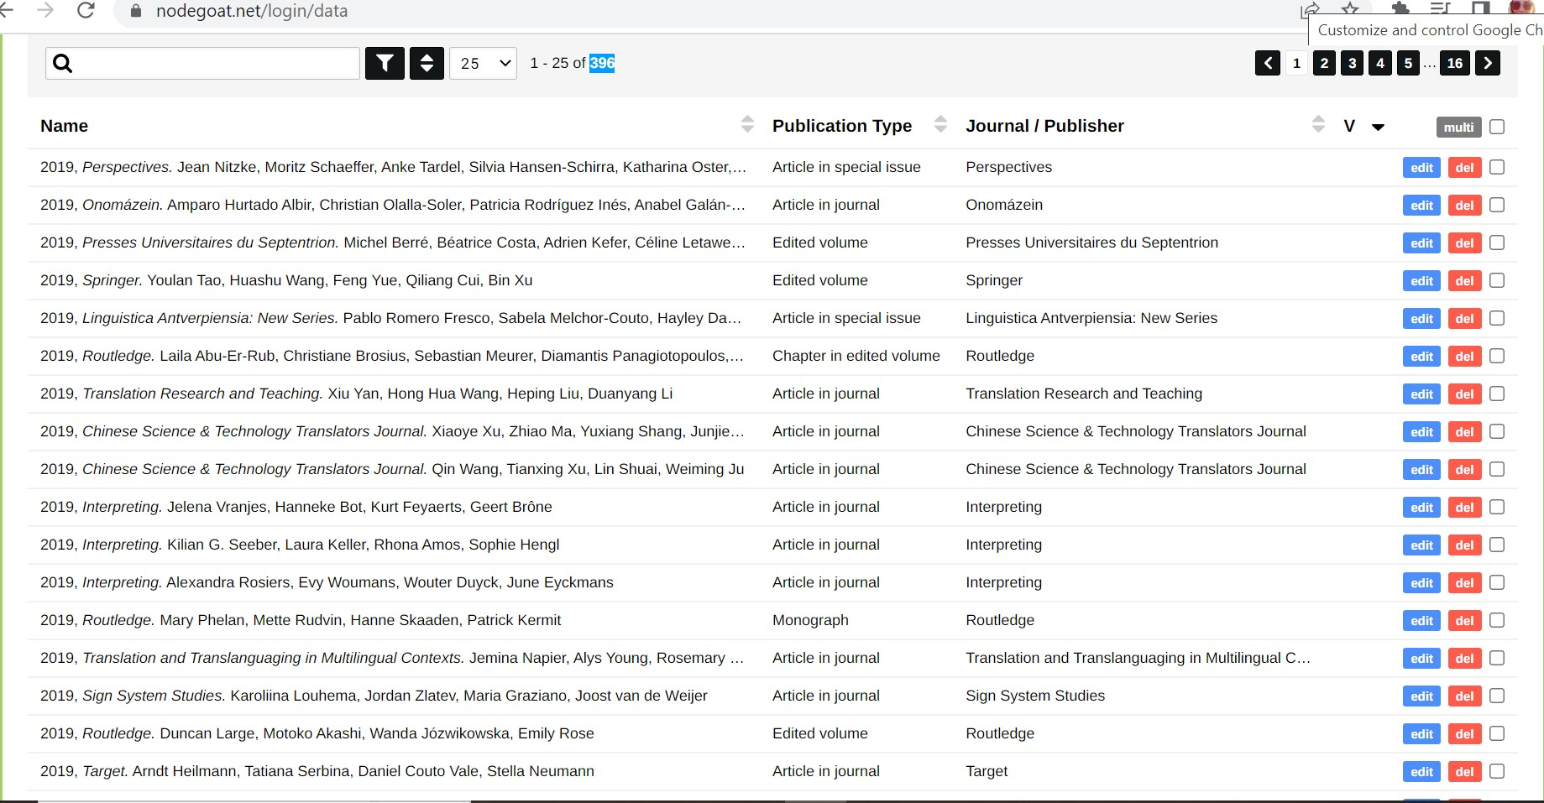
The list of 396 publications was imported to Nodegoat

Slide 28
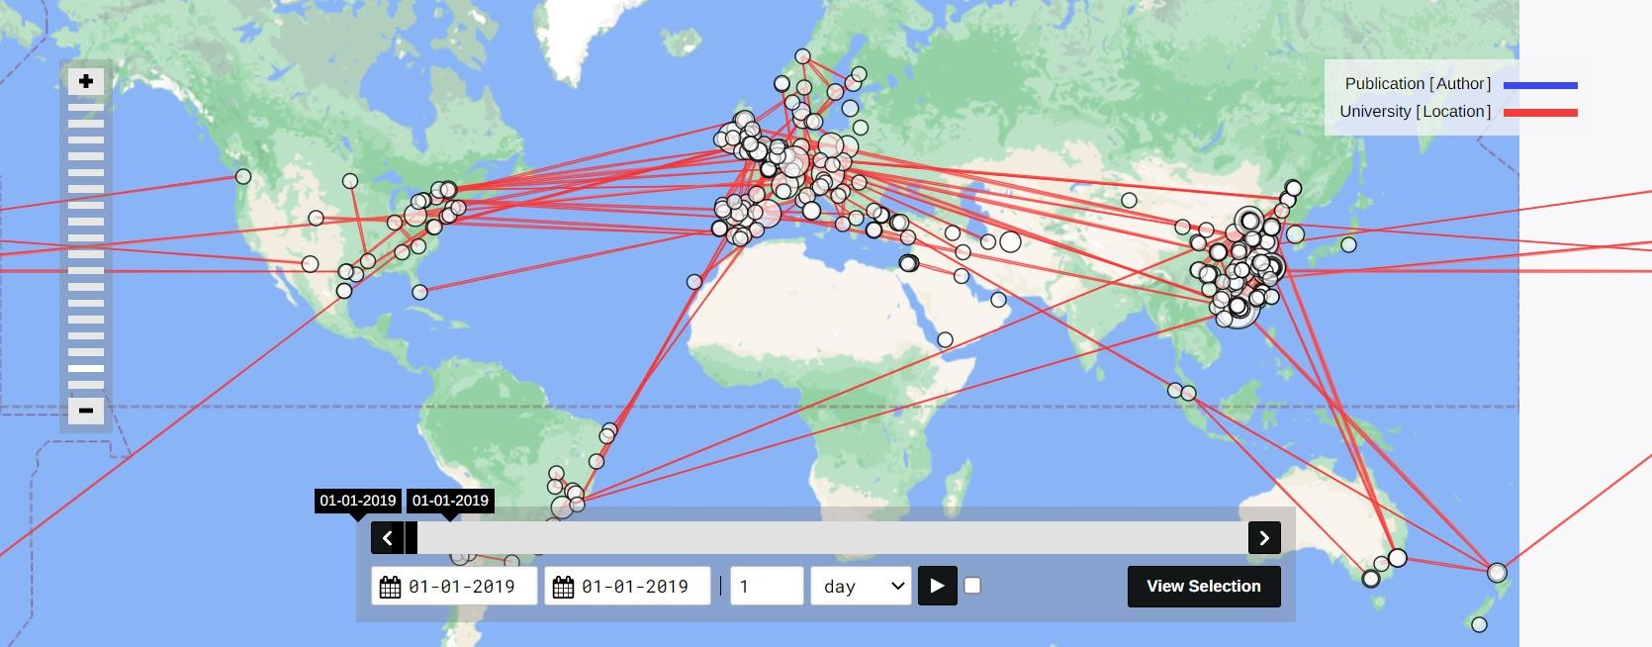
Geographical visualisation on Nodegoat: global overview for the year 2019

Slide 29
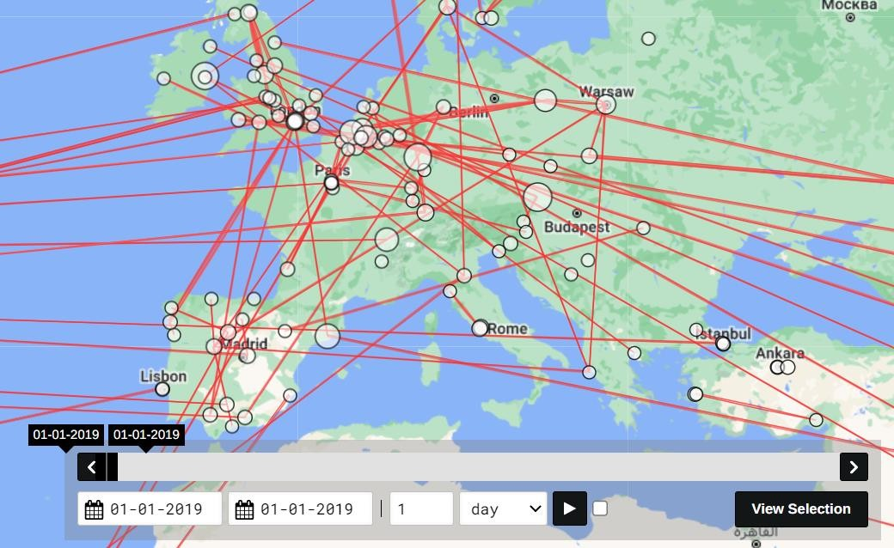
Geographical visualization of Europe: bigger nodes represent intra-city or intra-country co-
authoring. Lines represent inter-university co-authoring.

Slide 30
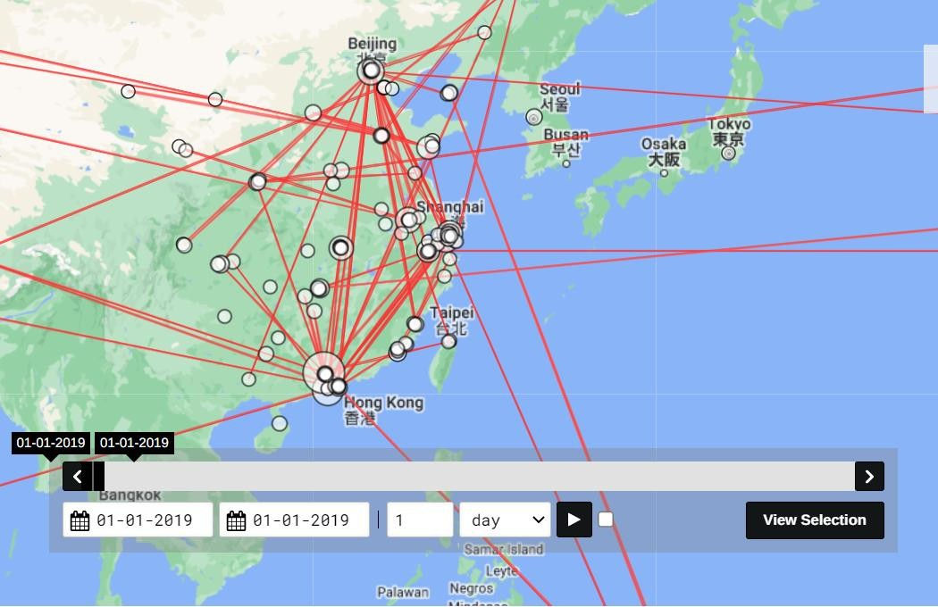
Geographical visualization of the co-authered publications in China

Slide 31
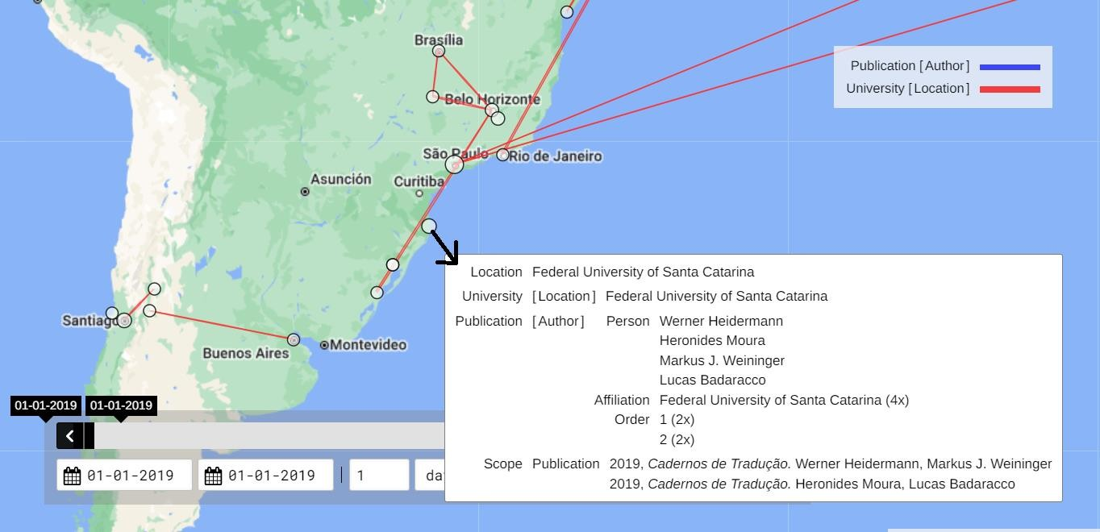
A view from South America: after clicking on a node, it is possible to see the details. For instance, all 4
authors who collaborated for one publication have the same affiliation (Federal University of Santa Catarina.

Slide 32
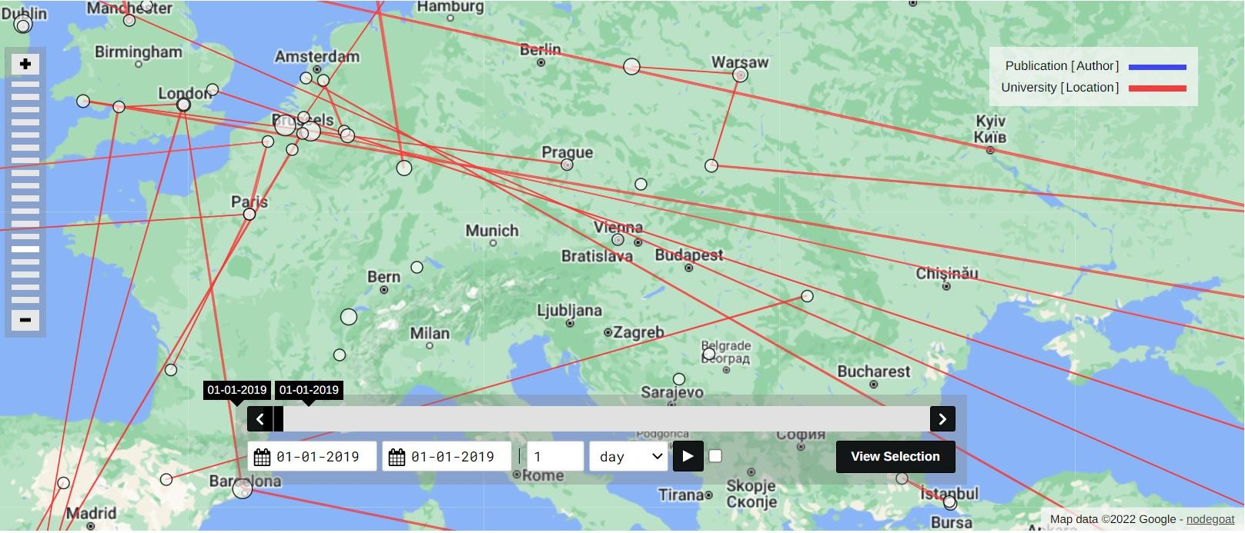
Filters on Nodegoat: geographical visualization of the co-authored articles in journals on the map of Europe

Slide 33
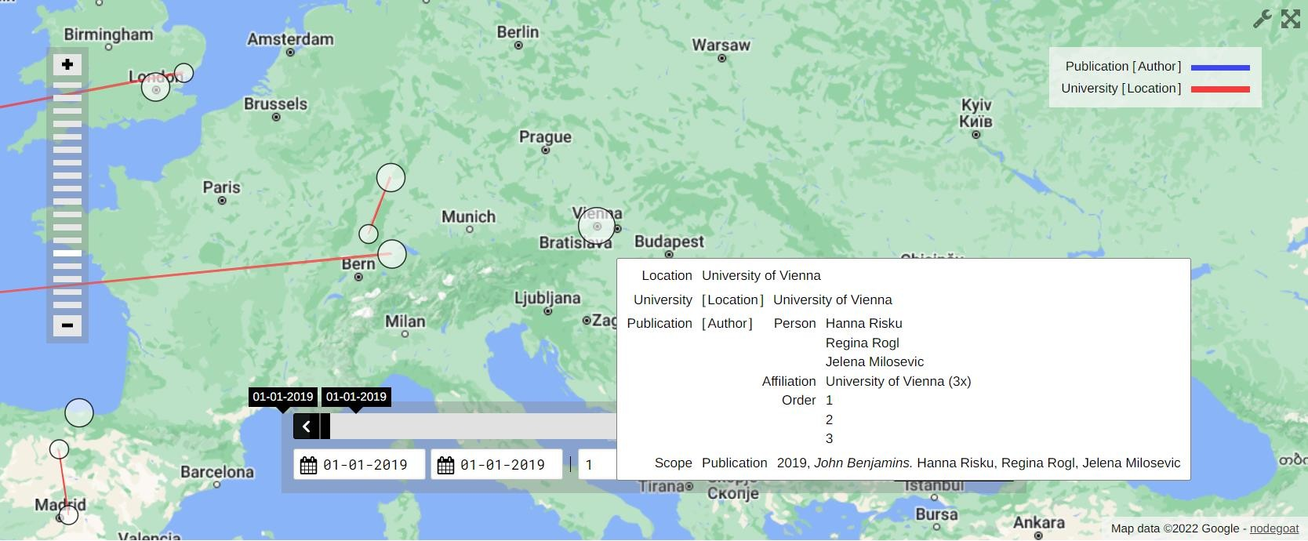
Chapters in edited volumes (much lower) in comparison with the previous map + a detail from Vienna.

Slide 34
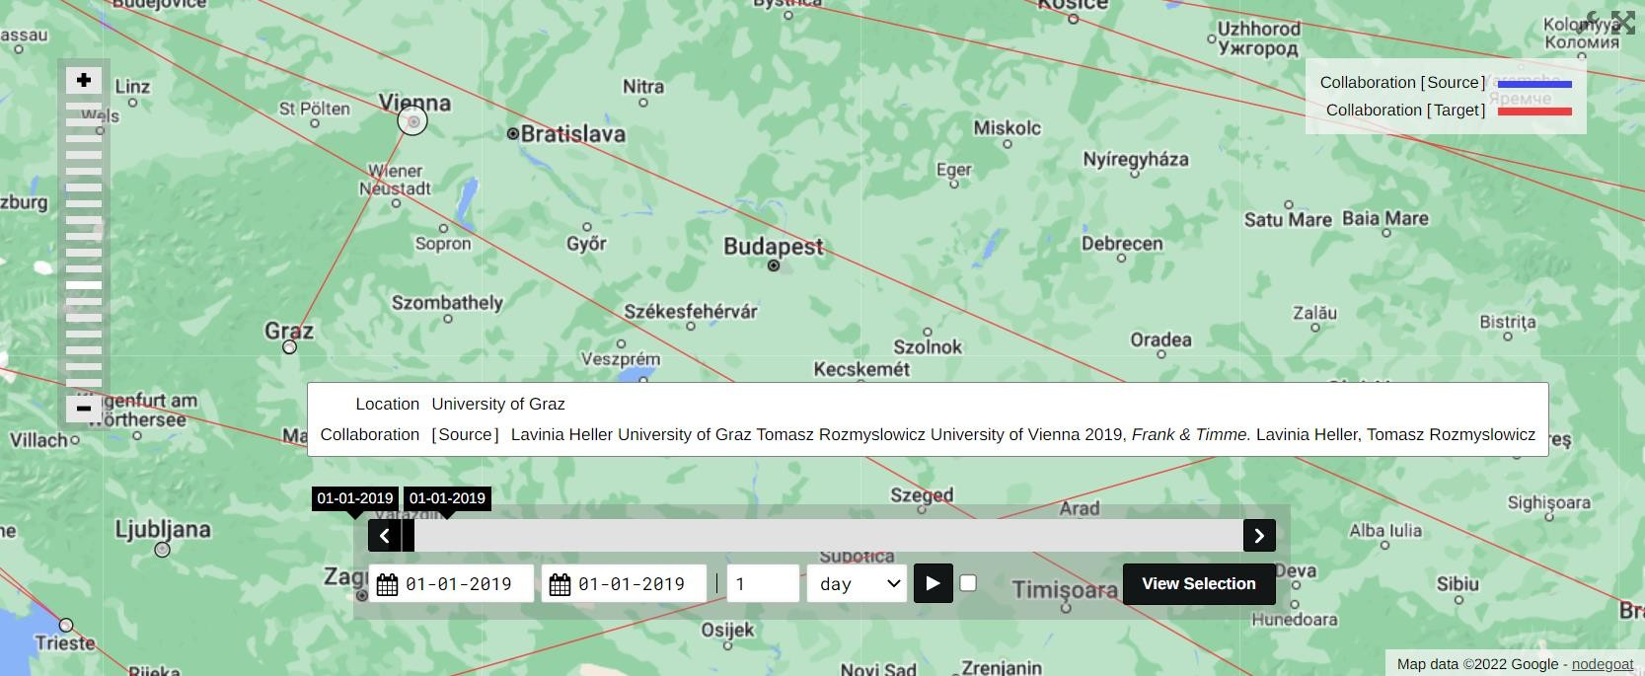
A detail from University of Graz: Lavinia Heller has collaborated with Tomasz
Rozmyslowicz from University of Vienna.

Slide 35
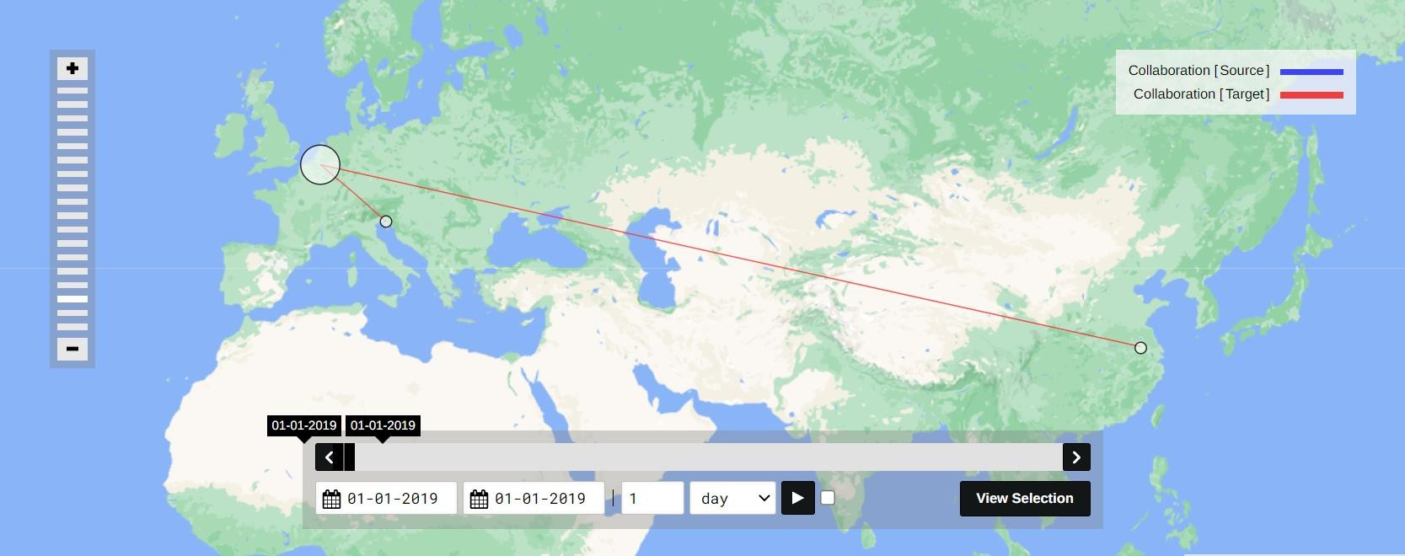
KU Leuven co-authoring: 6 intra-university co-authored publications + 2 inter-university publications with University of Trieste (Italy) and Nanjing University of Aeronautics and Astronautics

Slide 36
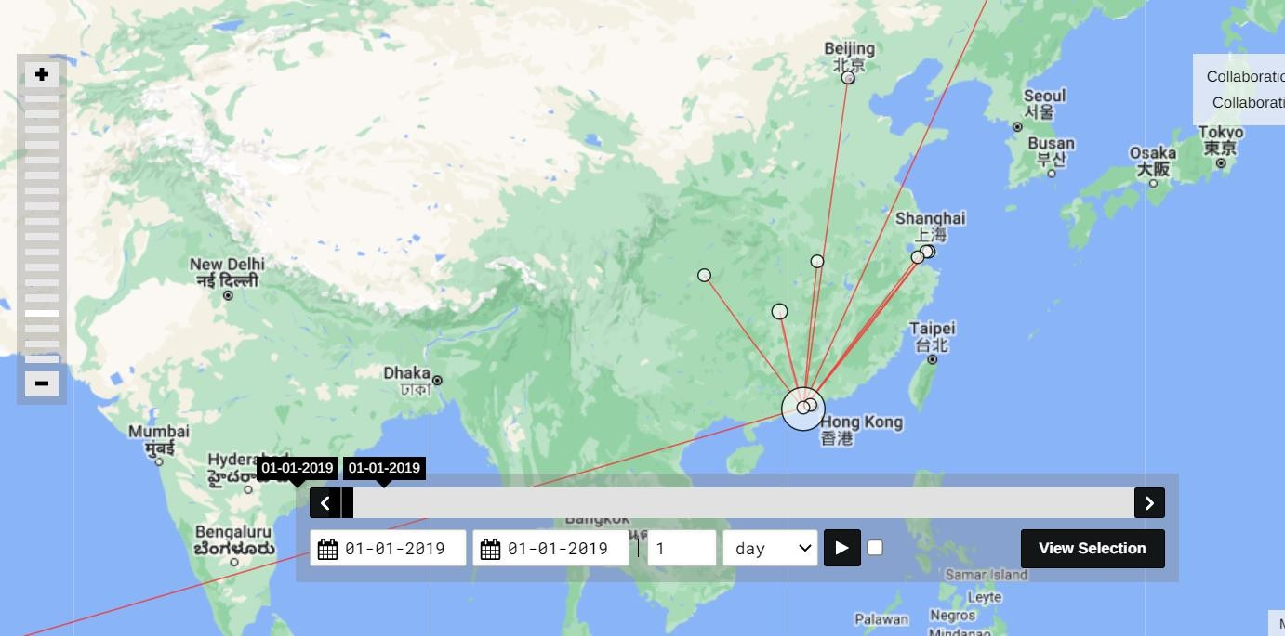
University of Macau co-authoring: 3 intra-university publications + 13 inter-university publications: University of São Paolo, Shanghai International Studies University, Jiaxing University, Harbin Normal University, Hunan University of Humanities, Science and Technology, Beijing Foreign Studies University, Yangtze Normal University, Lingnan University, Shanghai Jiaotong University, University of South China.

Slide 37
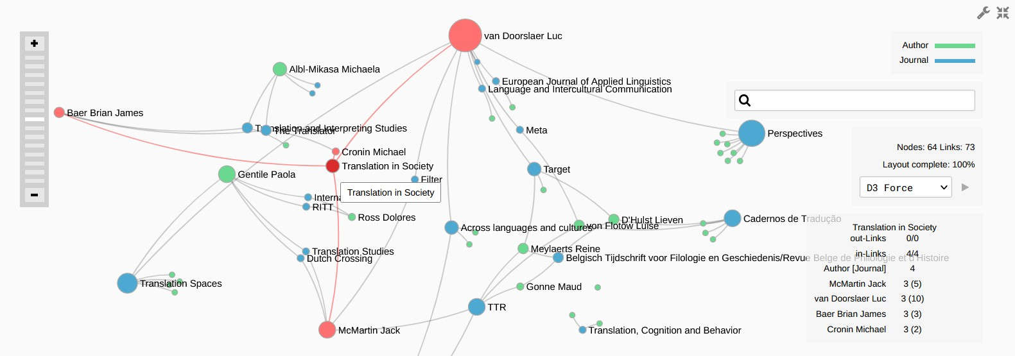

Slide 38
conclusion
→ scholarly networks in TS
→ scholarly collaborations (West-East, intercontinental, etc.)
→ (geo)political and ideological context
+ diachronic component:
→ historical development of collaborations and networks
→ TS situatedness impacting TS epistemology and conceptualization?

Slide 39
feedback & suggestions?!

